Slide 1
Week 2
Mapping Entities from an ER Diagram into a relational Database

Slide 2
Student Objectives
Upon completion of this video, you should be able to:
Look at an ER Diagram and turn each of the entities into a table in a relational model.

Slide 3

Now, let’s see/figure OUT/Comprehend the BEAUTY of the relational model!

Slide 4
Think about going from: → The Real World (a mini universe) TO A … →Model (ER Diagram) TO A … →Relational Database
Our only real rule is that: Relational Databases can only use these data structures:
Tables (Relations)
Rows
Columns
Cells

Slide 5
Representing ER Diagram Entities in the Relational Model
How do we represent entities such as Professor or Department in a relational database?
First
PROFESSOR
Name
Office
EmplD
Last
Ext

Slide 6
Ta Da….
First
PROFESSOR
Name
Office
Last
Ext
EmplD
Becomes this…
FirstName | LastName | EmpID | Office | Ext
FirstName | LastName | EmpID | Office | Ext
Laura | Reid | 11 | ST238 | 86905
Doug | Vancise | 22 | MC 421 | 83355
Michael | Atkinson | 15 | SSC 44 | 83456
Stuart | Rankin | 18 | MC 101 | 87678
Jamie | Andrews | 34 | MC 343 | 86789
Irving | Robinson | 56 | MC 102 | 86733

Slide 7
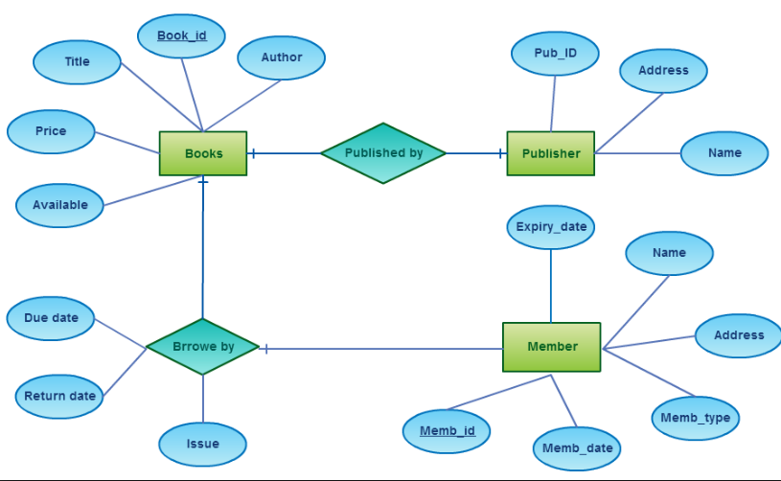
Another example of how to Map ER Entities to a relational Database:
Book
Book_ID | Title | Price | Author | Available
Publisher
Pub_ID | Name | Address
Member
Member_ID | Member_date | Member_price | Address | Name | Expiry_date

